Slide 1
HARDWARE ENGINEERING LAB PROJECT REPORT
VHDL IMPLEMENTATION OF AN ALARM CLOCK; GROUP: PARIS
ADITYA KUMAR, WIKTOR KOCHANEK, GORDAN KONEVSKI
HOCHSCHULE HAMM-LIPPSTADT, ELECTRONIC ENGINEERING 2022

Slide 2
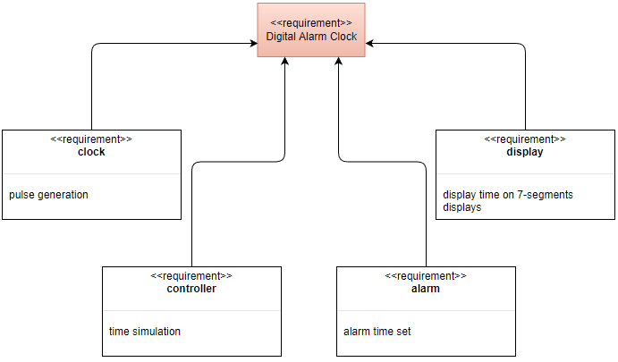
Motivation & Introduction

Slide 3
VHDL
Components
Clock: A component to generate a pulse.
Controller: A component to update time
Alarm: A component to set the Alarm
Display: A component to display the time

Slide 4
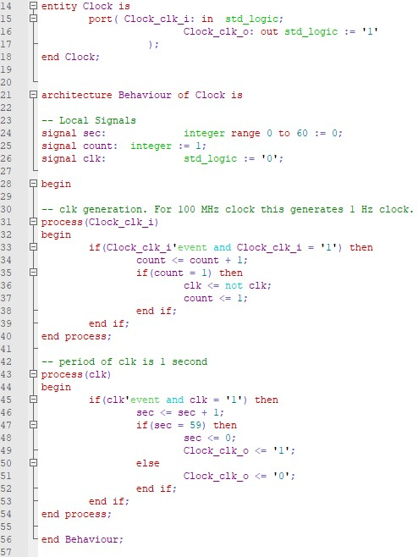
Clock

Slide 5
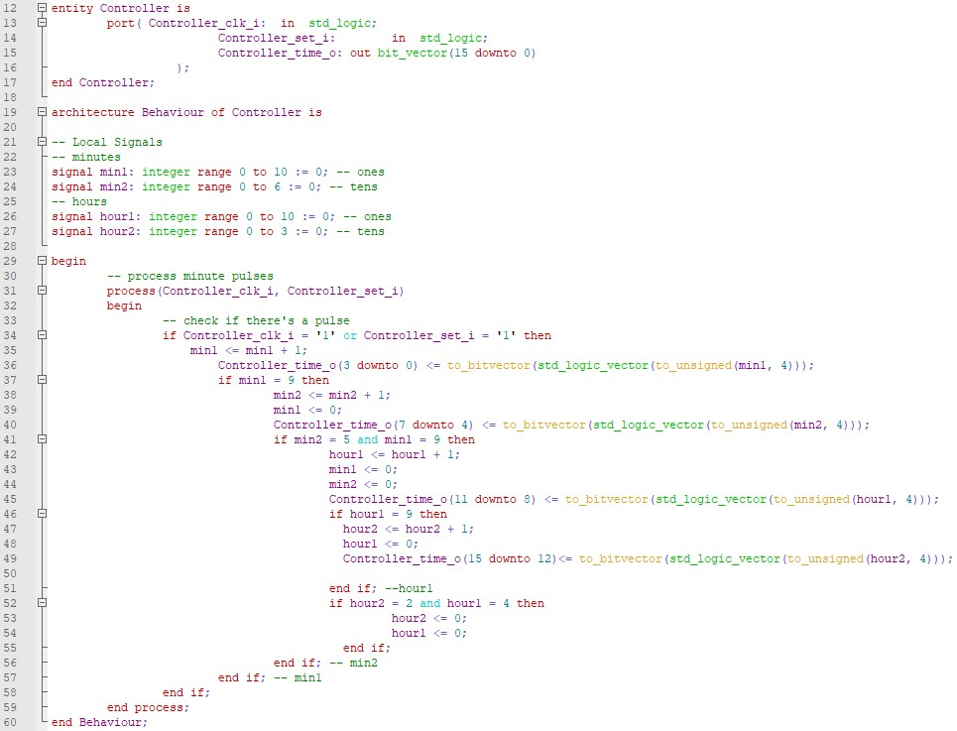
Controller

Slide 6
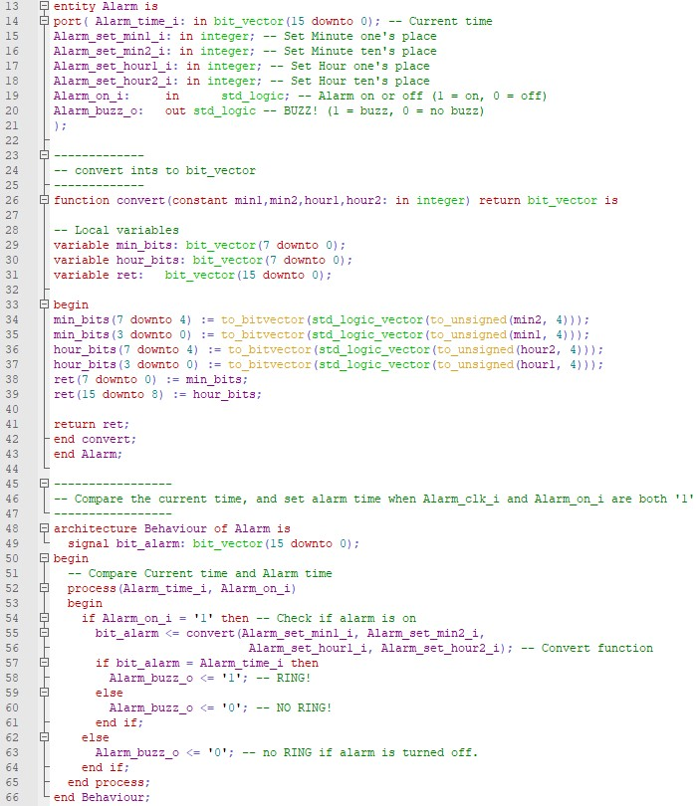
Alarm

Slide 7
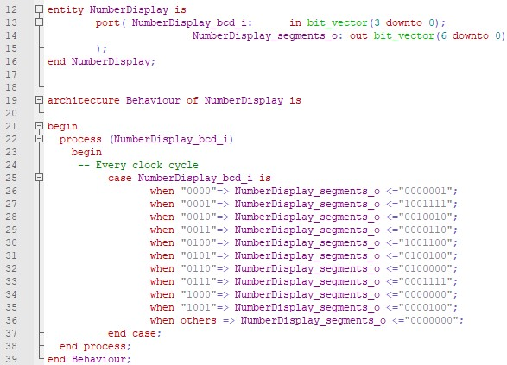
Number Display

Slide 8
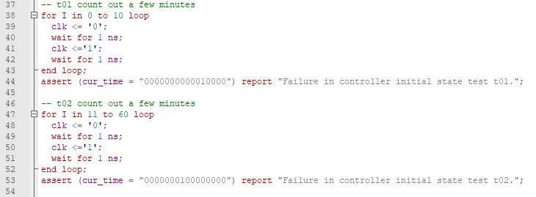
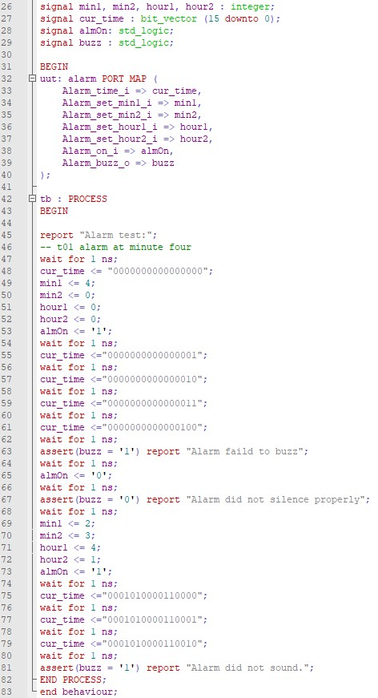
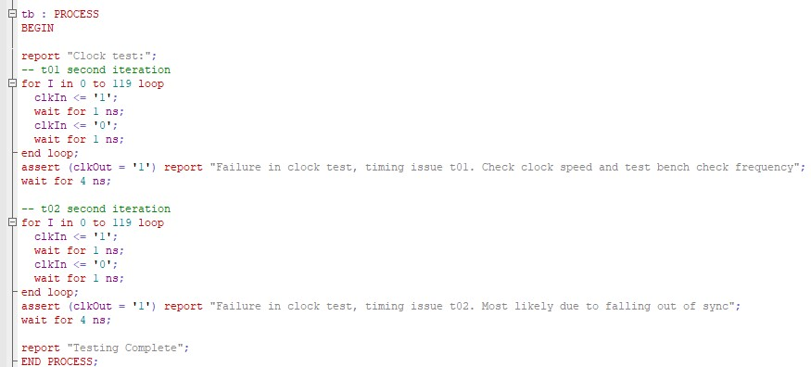
Test Bench

Slide 9
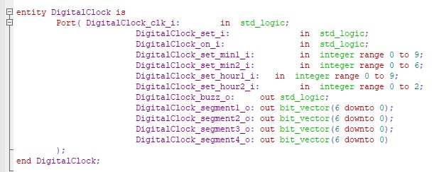
Digital Clock

Slide 10
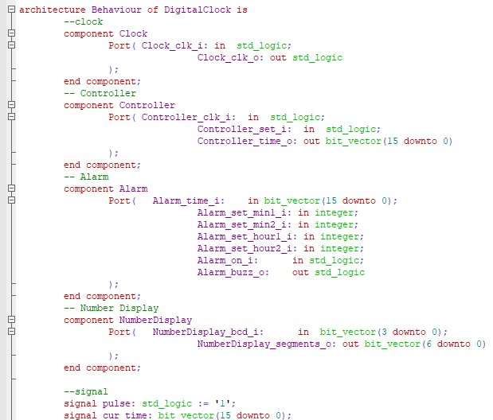
Digital Clock

Slide 11
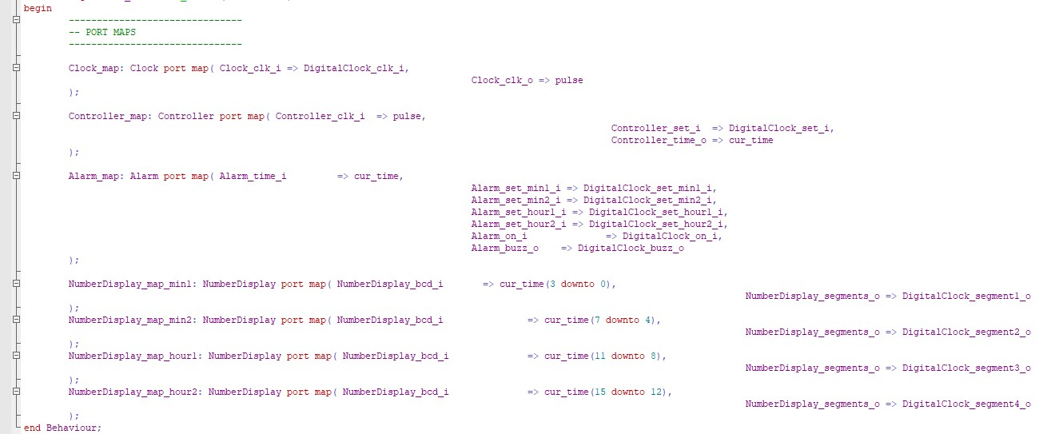
Digital Clock

Slide 12
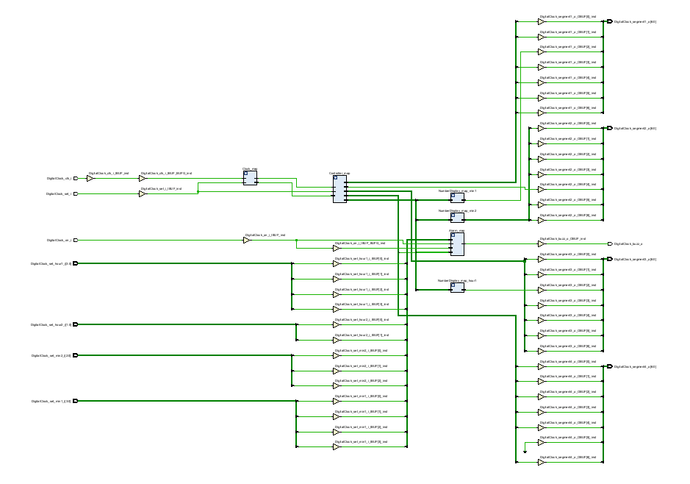
PCB Schematic and Design
Vivado as a chosen tool
Complex Schematic
FPGA implementation skipped (hardware unavailable)

Slide 13
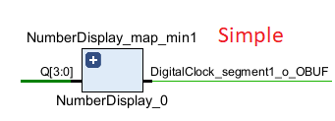
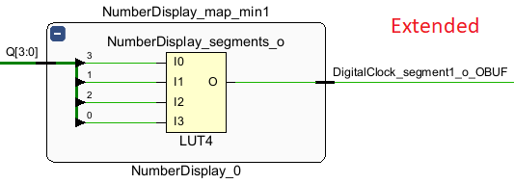
Benefits of Vivado as a Schematics Generator; Cons of Vivado as a VHDL Testing Tool
Simplified schematic
Smart gate generation
Clunky RTL and Technology schematics simulation

Slide 14
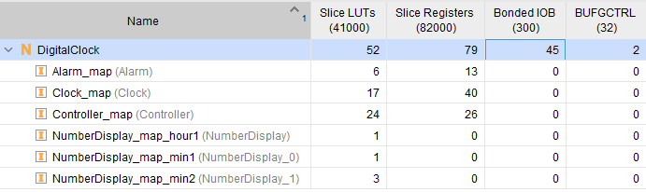
Info Table of the Schema

Slide 15
Conclusion
Digital alarm clock
VHDL implementation with multiple source files
Synthesis of the code using Vivado for future FPGA application

